Slide 1
DATABASE MANAGEMENT SYSTEM
Relational Set Operators

Slide 2
Objectives
2
To introduce the Relational Set Operators in Relational Database Model
Select
Project
Union
Intersect
Difference
Product
Join

Slide 3
Relational Set Operators
3
The data in relational tables are of limited value unless the data can be manipulated to generate useful information.
Relational algebra defines the theoretical way of manipulating table contents using the eight relational operators: SELECT, PROJECT, JOIN, INTERSECT, UNION, DIFFERENCE, PRODUCT,
The relational operators have the property of closure; that is, the use of relational algebra operators on existing relations (tables) produces new relations.
DBMS must support the key relational operators SELECT, PROJECT, and JOIN. Very few DBMSs are capable of supporting all eight relational operators.

Slide 4
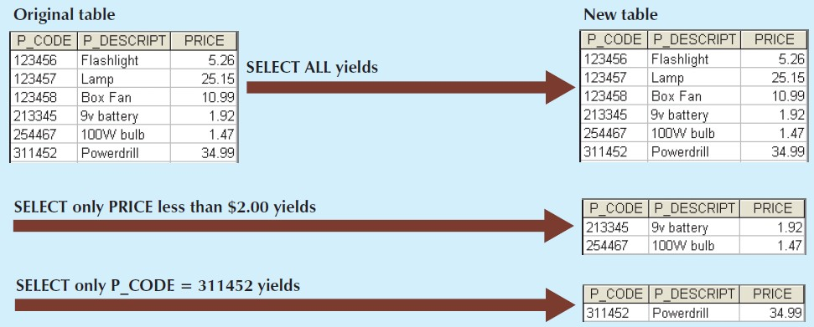
Select
4
SELECT, also known as RESTRICT, yields values for all rows found in a table that satisfy a given condition. (horizontal subset of a table)

Slide 5
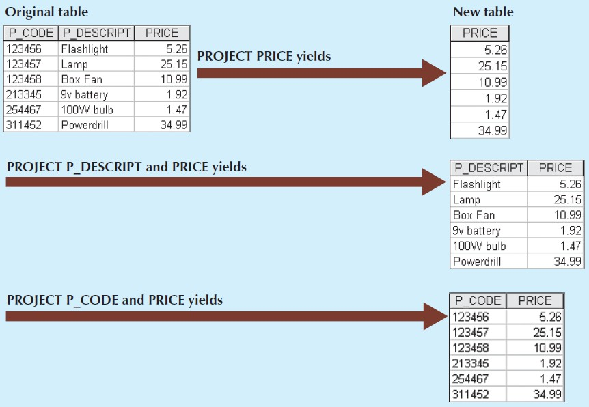
Project
5
PROJECT yields all values for selected attributes. (vertical subset of a table)

Slide 6
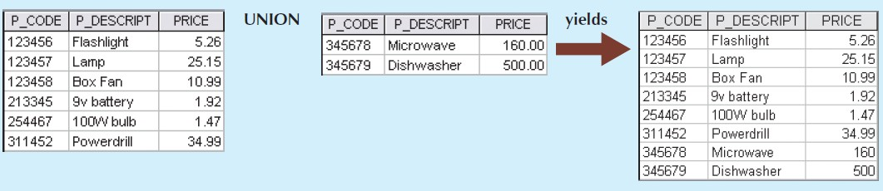
Union
6
UNION combines all rows from two tables, excluding duplicate rows. The tables must have the same attribute characteristics to be used in the UNION.
(union-compatible, the columns and domains must be compatible)

Slide 7
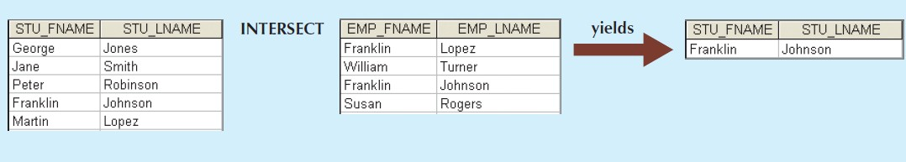
Intersect
7
INTERSECT yields only the rows that appear in both tables. (tables must be union-compatible, for example, you cannot use INTERSECT if one of the attributes is numeric and one is character-based).

Slide 8
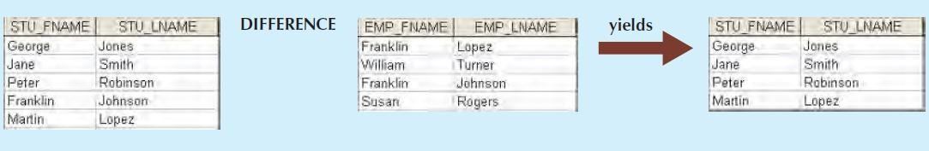
Difference
8
DIFFERENCE yields all rows in one table that are not found in the other table; that is, it subtracts one table
from the other. (tables must be union-compatible)
Note that subtracting the first table from the second table is not the same as subtracting the second table from the first table.

Slide 9
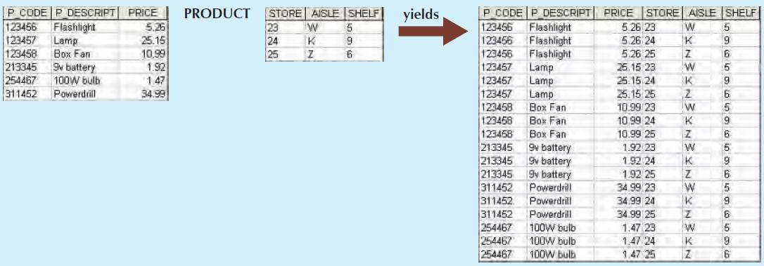
Product
9
PRODUCT yields all possible pairs of rows from two tables (also known as the Cartesian product). If one table has six rows and the other table has three rows, the PRODUCT yields a list composed of 6 × 3 = 18 rows.

Slide 10
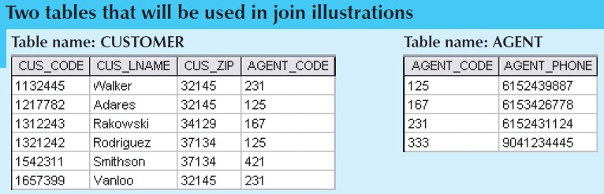
Join
10
JOIN allows information to be combined from two or more tables. JOIN is the real power behind the relational
database, allowing the use of independent tables linked by common attributes.
For Example if we have following tables,

Slide 11
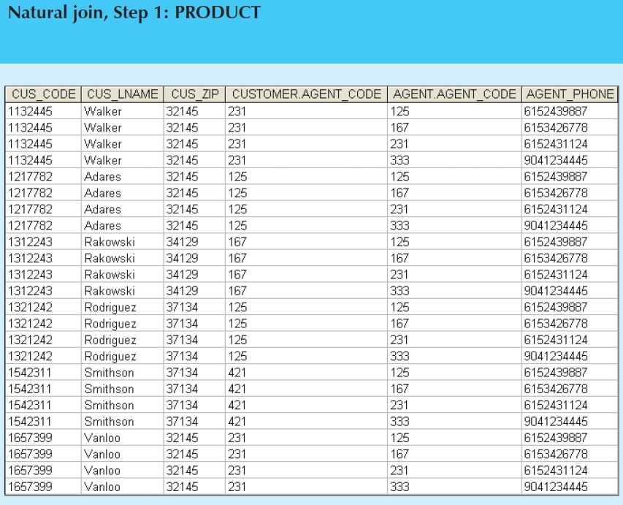
Natural Join
11
A natural join links tables by selecting only the rows with common values in their common attribute(s).
A natural join is the result of a three-stage process:
1. A PRODUCT of the tables is created.

Slide 12
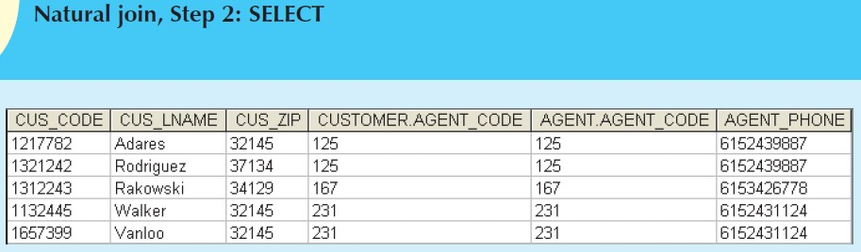
Natural Join (contd.)
12
2. A SELECT is performed on the output of Step 1 to yield only the rows for which the AGENT_CODE values are equal. The common columns are referred to as the join columns.

Slide 13
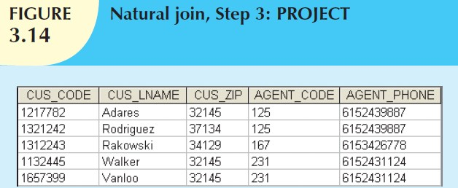
Natural Join (contd.)
13
3. A PROJECT is performed on the results of Step 2 to yield a single copy of each attribute, thereby eliminating duplicate columns.

Slide 14
Other Forms of Join
14
Another form of join, known as equijoin, links tables on the basis of an equality condition that compares specified columns of each table. The outcome of the equijoin does not eliminate duplicate columns, and the condition or criterion used to join the tables must be explicitly defined. The equijoin takes its name from the equality comparison operator (=) used in the condition.
If any other comparison operator is used, the join is called a theta join.
An inner join is a join that only returns matched records from the tables that are being joined. (natural join, equijoin and theta join are often classified as inner join).
In an outer join, the matched pairs would be retained, and any unmatched values in the other table would be left null.

Slide 15
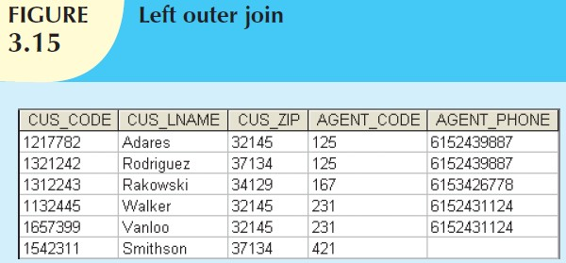
Other Forms of Join (contd.)
15
An outer join is NOT the opposite of an inner join, the outer join still returns all of the matched records that the inner join returns, plus it returns the unmatched records from one of the tables. There are two types of outer join:
A left outer join yields all of the rows in the CUSTOMER table, including those that do not have a matching value in the AGENT table.

Slide 16
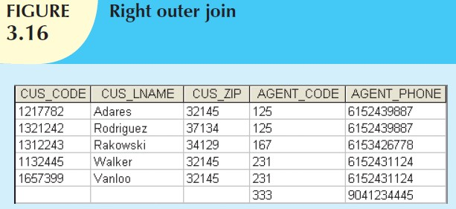
Other Forms of Join (contd.)
16
2. A right outer join yields all of the rows in the AGENT table, including those that do not have matching values in the CUSTOMER table.

Slide 17
Conclusion
17
In this Lecture, we…
Introduced following
Database Model:
Select
Project
Union
Intersect
Difference
Product
Join
Relational
Set Operators
in Relational

